Slide 1
UNIVERSITÀ DEGLI STUDI DI NAPOLI FEDERICO II
WEB TECHNOLOGIES – LECTURE 24
WEB TESTING
Luigi Libero Lucio Starace, PhD
luigiliberolucio.starace@unina.it https://luistar.github.io https://www.docenti.unina.it/luigiliberolucio.starace

Slide 2
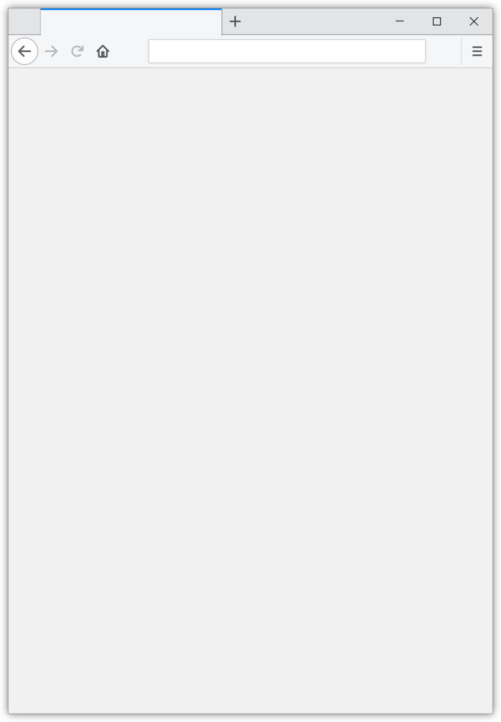
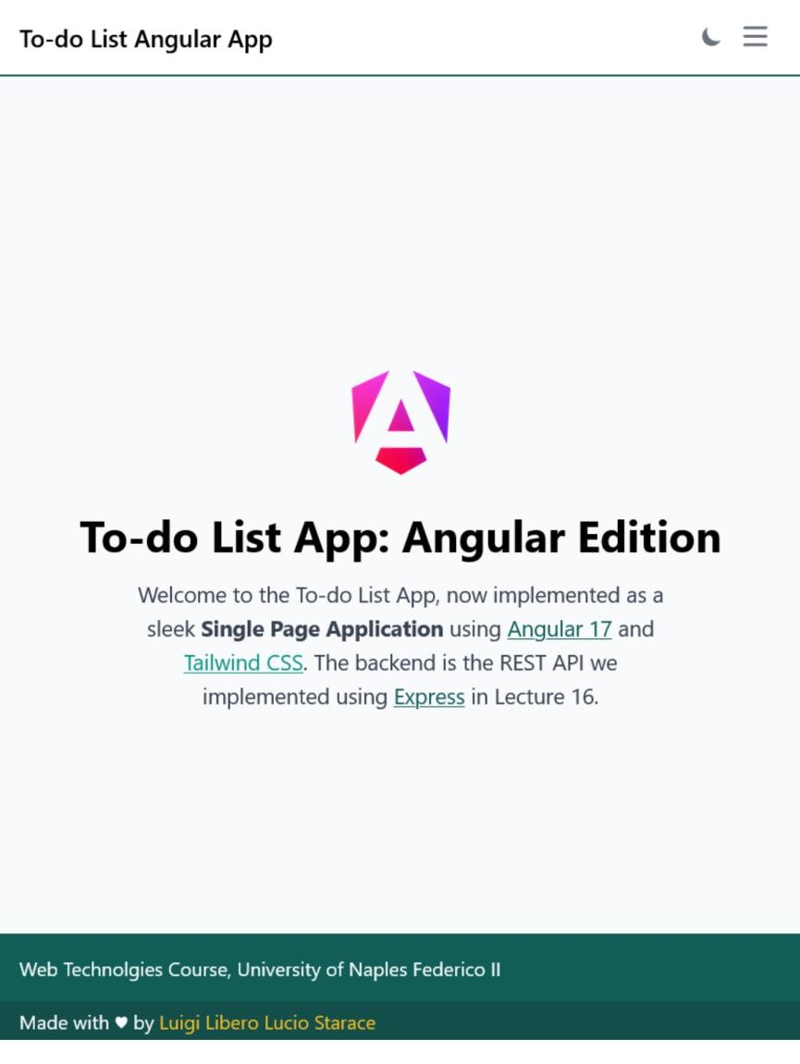

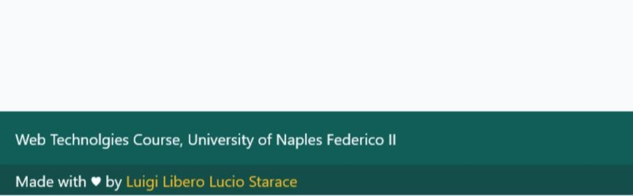
HIGH QUALITY WEB APPS
Error 500
Internal Sever Error
We have learned to design and implement modern, secure web apps
One piece missing before we can actually deliver high quality apps
Guess what?
Testing!
Testing is fundamental to catch as many bugs as possible before they reach production (where they can cost quite a lot of $$$!)

Slide 3
SOFTWARE VERIFICATION (REDUX)
Practices aimed at ensuring that a software satisfies a specification
Dynamic Verification (involves program execution)
Software Testing
Static Verification (does not involve program execution)
Code Review
Static Analysis (e.g.: Taint Analysis)
Automated Verification (model checking)
The goal is to catch defects or bugs before the product is released

Slide 4
SOFTWARE TESTING (REDUX)
A software test is a sequence of actions designed to evaluate a particular aspect or functionality of a software
The Software Under Test is often called SUT
A Test generally consists in:
Ensuring the required pre-conditions are fulfilled (Arrange phase)
Executing one or more actions (Act phase)
Checking that the SUT behaved as intended (Assert phase)

Slide 5
TESTING LEVELS (REDUX)
Testing can be performed at different levels:
Unit testing
Tests a single unit (e.g. a class, or a method)
Integration testing
Checking that different units work together as intended
System testing
Targets the system as a whole, against its specification
End-to-End (E2E) testing
Targets the SUT from the viewpoint of its intended end users

Slide 6

THE TESTING PYRAMID
Manual Exploratory Testing
Slower, expensive
Closer to users
E2E
Tests
System Tests
Integration Tests
Unit Tests
Faster, cheaper
Closer to code
Number of tests

Slide 7
WEB APPLICATION TESTING
Web Apps, like any software, should be properly tested to ensure high quality. Some peculiar challenges arise:
When doing Unit Testing, we need to deal with:
Async code
Dependencies on external services
When doing End-to-End Testing, we need to deal with:
Fragility
Flakyness

Slide 8
UNIT TESTING ANGULAR APPS

Slide 9





UNIT TESTING ANGULAR APPS
Angular comes with all we need to test our apps using Jasmine
By default, test code is written in spec (specification) files
Stub spec files are also generated by default by the Angular CLI
Typically placed in the same directory as the component/service they test
Widely adopted naming convention is to add «.spec» to the name of the tested component/service
calculator.service.ts
app
services
calculator
calculator.service.spec.ts

Slide 10
JASMINE SPEC FILES
import { TestBed } from '@angular/core/testing';
import { CalculatorService } from './calculator.service';
describe('CalculatorService', () => { let service: CalculatorService;
describe() creates a set (a.k.a. suite) of specs (or tests).
Same idea as a JUnit Test Class. It groups related tests.
beforeEach(() => {
TestBed.configureTestingModule({});
service = TestBed.inject(CalculatorService);
TestBed is the most important Angular
Testing Utility. Provides methods to create
components and services in unit tests.
});
it('should be created', () => { expect(service).toBeTruthy(); });
it('should sum two positive numbers correctly', () => {
expect(service.sum(42,58)).toEqual(100);
});
});
it() defines a single spec.
Same idea as a @Test method in Junit.

Slide 11
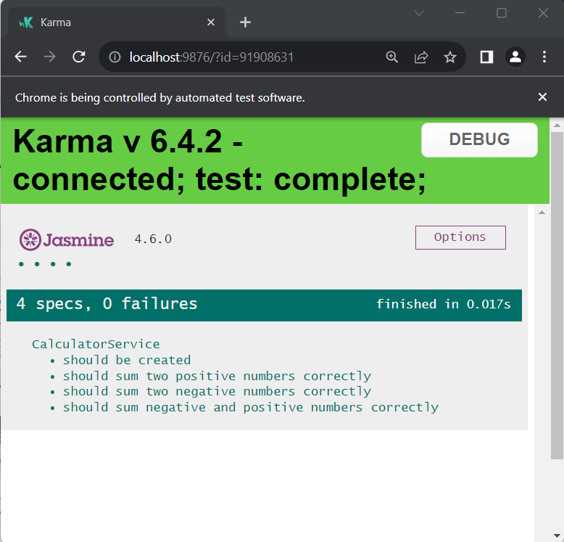
UNIT TESTING ANGULAR APPS
The command ng test build the application, and launches the Karma Test Runner
Karma picks up any spec file and runs it
Karma also produces a test execution report

Slide 12
TESTING SERVICES
import { TestBed } from '@angular/core/testing'; import { AuthService } from './auth.service';
describe('AuthService', () => { let service: AuthService;
beforeEach(() => { service = TestBed.inject(AuthService); });
it('should detect malformed tokens', () => {
let malformed = "malformed"; expect(service.verifyToken(malformed)).toBe(false);
});
it('should detect expired tokens', () => {
let expired = "eyJhbGciO...c9-p0"; //expired on 2000/01/01 expect(service.verifyToken(expired)).toBe(false);
});
//other tests omitted
}
• Services with no dependencies are easy to test

Slide 13
TESTING AND DEPENDENCIES
Typically, the services/components we test will depend on other services/components
For example, the RestBackend Service depends on HttpClient
The TodoPage Component depends on the RestBackend Service
In these scenarios, unit testing becomes a little more challenging
Suppose TodoPage Component is not showing the expected To-dos
Is it because of a bug in the TodoPage Component?
Is it because of a bug in the RestBackend Service?
Is it because of a bug in the external REST Backend?
Or a combination of all the above?

Slide 14
TESTING AND DEPENDENCIES
This issue goes far beyond fault localization challenges
In many cases, we may not want to use real production code units during tests
Think of a TemperatureService that returns the current temperature in Naples by invoking some external REST API.
What if we want to test what happens in our component when the temperature goes below zero?
Do we wait for a few years and run the test as soon as we get an exceptionally cold day?

Slide 15
TESTING IN ISOLATION
Good unit tests should test a code unit in isolation
The outcome should not depend on external code units
How can achieve this when our code units have dependecies?
The solution is to use Test Doubles
Test Doubles are replacements for production objects that are typically used in tests
Instead of using the real TemperatureService, se use a TemperatureServiceDouble which always return a -42°C temperature!

Slide 16
TESTING AND DEPENDENCY INJECTION
The Dependency Injection mechanism is a precious support when we want to use Test Doubles
During tests, we can configure the injector to resolve dependencies using Test Doubles instead of the real deal!
Writing Test Doubles from scratch still takes a good deal of effort
Lots of boilerplate code to write
Luckily, testing frameworks can support us in creating Doubles
Jasmine, for example, supports the concept of Spies
A Spy is a test double that can «mock» any function

Slide 17
JASMINE SPIES
let todos = [{id: 1, todo: "foo"}, {id: 2, todo: "bar"}];
restBackendSpy = jasmine.createSpyObj('RestBackendService', ['getTodos']); restBackendSpy.getTodos.and.returnValue(of(todos));
The code above:
Creates RestBackendService Spy, mocking its getTodos() method
Configures the Spy to always return an Observable of a given list of two To-do Items every time the getTodos() method is invoked
If we use the Spy in place of the real RestBackendService, our test will not depend on the Service, nor on the (external) REST API!

Slide 18
TESTING THE TO-DO PAGE COMPONENT
it('should properly fetch to-do items', () => {
let todos = [{id: 1, todo: "foo"}, {id: 2, todo: "bar"}];
restBackendSpy = jasmine.createSpyObj('RestBackendService', ['getTodos']);
restBackendSpy.getTodos.and.returnValue(of(todos)); component.restService = restBackendSpy;
component.fetchTodos();
fixture.detectChanges();
expect(component.todos.length).toEqual(2);
const element: DebugElement = fixture.debugElement; //get <app-todo-page> elem const list = element.query(By.css('ul'));
const content = list.nativeElement.textContent; expect(content).toContain('foo'); expect(content).toContain('bar');
})

Slide 19

COMPUTING CODE COVERAGE
We can also easily compute code coverage metrics
A possible indicator of how «well» we tested the app
@luigi ➜ D/O/T/W/2/e/2/angular-todo-list $ ng test --no-watch --code-coverage Browser application bundle generation complete.
...
Chrome 121.0.0.0 (Windows 10): Executed 18 of 18 SUCCESS
TOTAL: 18 SUCCESS
=============================== Coverage summary ===============================
Statements : | 45.45% | ( | 75/165 )
Branches : | 21.21% | ( | 7/33 )
Functions : | 43.39% | ( | 23/53 )
Lines : | 42.58% | ( | 66/155 )
================================================================================
@luigi ➜ D/O/T/W/2/e/2/angular-todo-list $

Slide 20
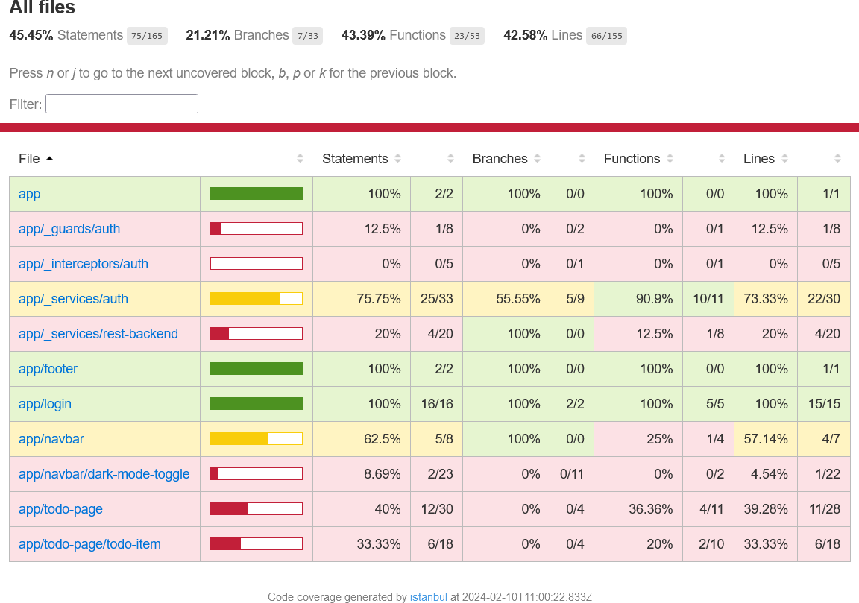
COMPUTING CODE COVERAGE
An HTML coverage report is generated in the /coverage directory
We can also inspect each file separately and see which lines of code were covered by tests

Slide 21
END-TO-END TESTING

Slide 22
END-TO-END (E2E) TESTING
Goal:
Test the system as a whole
From the point of view of its intended end users
Each test replicates a realistic usage flow
Interacting with the external interfaces of the system
As end-users do!

Slide 23


E2E TESTING: REST APIs
When the web app is a REST API
REST endpoints are the external interface
End users are other programs sending HTTP requests
E2E tests should send HTTP requests and check that the responses are correct according to specification
REST API
Url | Method | Description
/todos | GET | Get all To-dos
/todos/:id | GET | Get To-do by ID
/todos | POST | Save To-do
/todos/:id | PUT | Update To-do by ID
/todos/:id | DELETE | Delete To-do by ID
/auth | POST | Login request
/signup | POST | Create new user

Slide 24
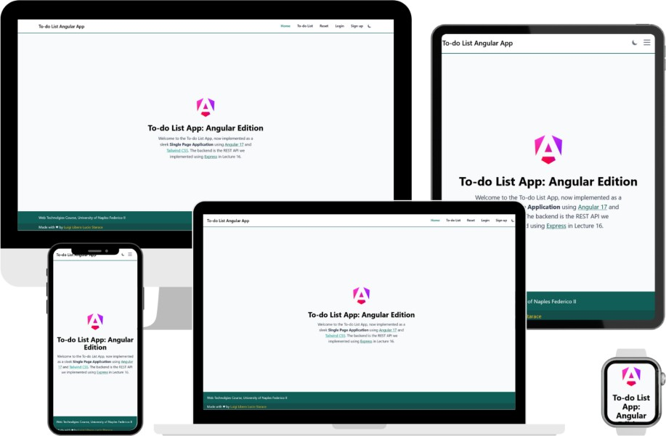
E2E TESTING: WEB APPLICATIONS
When the web app is traditional web app or a SPA
Web pages are the external interface
End users are humans using a web browser
E2E tests should interact with the web pages, and check that they change correctly as a result of the interactions
We will refer to this kind of tests as E2E web tests

Slide 25
E2E REST API TESTS: EXAMPLES
Step | Description – Scenario: Successful login
1 | Send a POST HTTP request to /auth with payload {usr: "gerry", pwd: "sussman"}
2 | Check that the response has status code 200 OK
3 | Check that the returned value is a JSON of type {token: string}
4 | Check that response.token is a valid JWT token
Step | Description – Scenario: User inserts a new to-do item
1 | Send a POST HTTP request to /auth with payload {usr: "gerry", pwd: "sussman"}
2 | Check that response has status 200 OK, then extract and save the token in response body
3 | Send a POST HTTP request to /todos with payload {todo: "foobar", done: false} and authorization header set to «Bearer <TOKEN>», where <TOKEN> is the value extracted in Step 2
4 | Check that the response has status 200 OK
5 | Check that the response body contains a JSON with properties {todo: "foobar", done: false}

Slide 26
E2E WEB TESTS: EXAMPLES
Step | Description – Scenario: Successful login
1 | Visit login page
2 | Insert «gerry» in the username field
3 | Insert «sussman» in the password field
4 | Click on the «Login» button
5 | Check that user is redirected to homepage
6 | Check that the navbar contains «Hi, Gerry»
Step | Description – Scenario: User inserts a new to-do item
1 | Visit todos page
2 | Insert «example» in the to-do input field
3 | Click on the «Save to-do» button
4 | Check that the «example» to-do item has been added to the list

Slide 27
KEY STEPS IN E2E WEB TESTING
Whether it is done manually or in an automated fashion, E2E testing basically follows the pseudocode listed hereafter:
execute(test suite):
foreach test scenario in test suite:
foreach step in test scenario:
select the element to interact with (button, text field, ...)
interact with it (click, fill, check some property holds, ...)

Slide 28


MANUAL AND AUTOMATED E2E TESTING
E2E Testing can be done manually, or be automated
Manual E2E Testing
Human testers are given a script with a detailed list of steps to follow to replicate user scenarios
They follow and replicate the script step by step, reporting any issue
The images in this slide are AI-generated (by DALL-E 3)
Automated
Testers develop test software
(test suites) that can automatically
simulate user scenarios
Test suites can be re-executed multiple times

Slide 29
E2E TESTS: MANUAL VS AUTOMATED
No programming knowledge required
Time-consuming, tedious, and
error-prone activity
Does not scale well…
Repeat for each new release of the app
Repeat on all major browsers
Repeat on different devices
Programming and testing knowledge required
Higher initial costs, but the tests can be re-executed multiple times with little additional effort
Test code needs maintainance (i.e., to be updated as the web app evolves)
Tests may be flaky and/or fragile

Slide 30
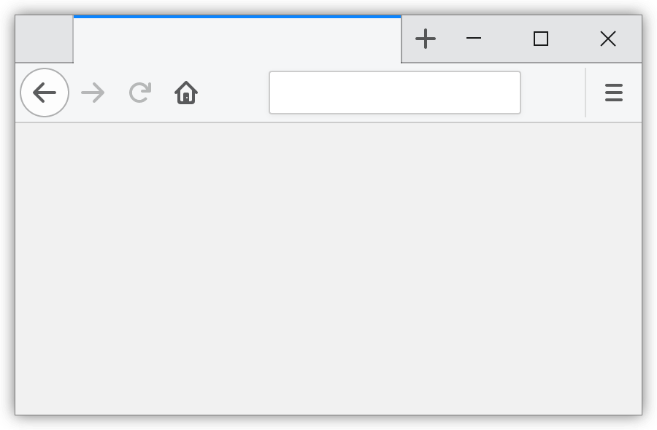
AUTOMATED E2E WEB TESTS
Automated E2E web tests are basically test code that leverages dedicated libraries to remotely control a web browser
Navigate to URLs
Locate and interact with web page elements
Thanks to these libraries, E2E test code can simulate user interactions with a web app
These libraries can be useful not only for testing, but also for other tasks!
Scraping (extracting data from web sites)
Crawling (navigating web sites)
E2E Test Code
Browser Automation Library API
Remotely-controlled Browser

Slide 31

SELECTING WEB PAGE ELEMENTS
Selecting (locating) elements with which to interact is a crucial part of E2E web testing. Three main approaches (locator strategies) exist:
Absolute coordinates
Identify elements based on screen coordinates
click(200, 300); //click at coordinates 200,300
Visual-based locators
Identify elems based on their appearence, using image-matching algorithms
click( );
//click on the element matching the provided image
Layout-based locators
Identify elements based on layout properties (e.g.: use CSS selectors!)
click(".item button.buy"); //click on the button.buy contained in a .item

Slide 32
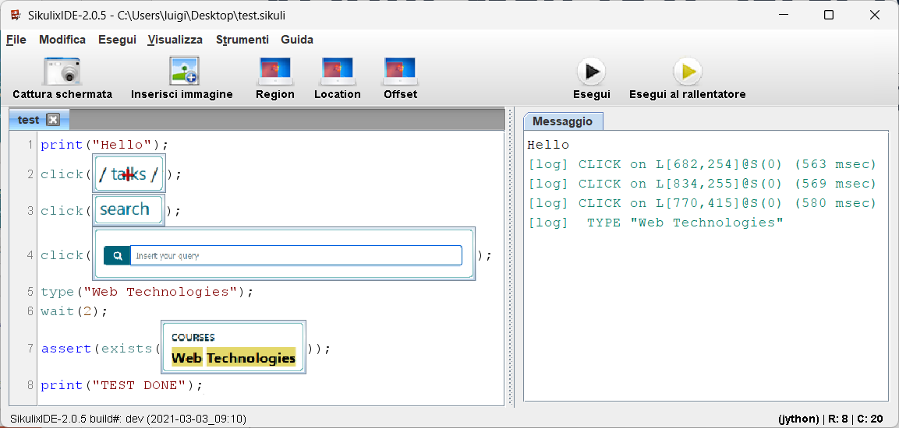
VISUAL WEB TEST SELECTORS
Tools like SikuliX allow users to write E2E tests using visual locators
Live demo time!

Slide 33
E2E WEB TESTING CHALLENGES
Two key challenges arise when doing E2E web testing
Fragility
Flakiness

Slide 34



E2E WEB TEST FRAGILITY
E2E web tests are often fragile w.r.t. web app evolution
Even minor changes to the web app or test environment can break locators
As a result, tests become unable to interact with the correct elements
Time-consuming maintenance is required to repair broken locators
click(100, 200);
password
Login
username
Login
username
This locator breaks in v. 1.1!
The absolute coordinates do not correspond to the login button anymore!
password
Web App v. 1.0
Web App v. 1.1

Slide 35


E2E WEB TEST FRAGILITY
E2E web tests are often fragile w.r.t. web app evolution
Even minor changes to the web app or test environment can break locators
As a result, tests become unable to interact with the correct elements
Time-consuming maintenance is required to repair broken locators
click( );
Login
username
username
This locator breaks in v. 1.1! The specified image no longer matches the appearance of the login button!
password
password
Login
Login
Web App v. 1.0
Web App v. 1.1

Slide 36


E2E WEB TEST FRAGILITY
E2E web tests are often fragile w.r.t. web app evolution
Even minor changes to the web app or test environment can break locators
As a result, tests become unable to interact with the correct elements
Time-consuming maintenance is required to repair broken locators
click(".form button:first-of-type");
This locator breaks in v. 1.1!
A new button is added in .form before the login button. The test will incorrectly click on the new button!
password
Login
username
username
password
Sign up Login
Web App v. 1.0
Web App v. 1.1

Slide 37
LOCATOR STRATEGIES AND FRAGILITY
Good locators should be not too generic and not too specific
If too generic, they might easily select a different element than intended
If too specific, even minor changes might break them
Experience goes a long way in designing robust locators!
Coordinate-based locators are the most fragile
Visual-based locators are robust to layout changes, but fragile w.r.t. changes to the appearence of elements
Layout-based locators are robust w.r.t. purely visual changes, but more fragile w.r.t. layout changes
Layout-based locators are the most used in practice

Slide 38
E2E WEB TEST FLAKINESS
E2E web tests have a tendency to be flaky, i.e., behave inconsistently
The same test may pass or fail intermittently under identical conditions (i.e., no change to the web app or to the test)
This unpredictability is often caused by the non-determinism related to loading times or fetching data
Some times, for example, an external resource takes longer to return the data that needs to be visualized
As a consequence, tests might try to access elements which have not been rendered yet, resulting in errors (element not found)
Flakiness can be mitigated by using appropriate waiting strategies

Slide 39
E2E TEST ISOLATION
E2E web tests should run in isolation
No failure carry-over (one failing test does not affect subsequent tests)
Test execution order does not matter (tests can be executed in parallel)
Each test can be executed independently (easier to debug)
E2E isolation can be achieved in two ways:
Start from scratch. Each test runs in a brand-new, clean environment
Clean-up between tests. Make sure the clean and reset the environment
between tests

Slide 40


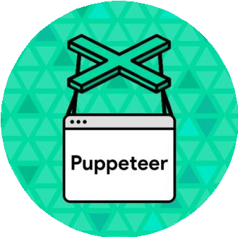

E2E WEB TESTING TOOLS
Selenium
Since 2009
Cross-browser
Cypress
Since 2014
Cross-browser
Puppeteer
By Google
Since 2017
Chrome-oriented
Playwright
By Microsoft
Since 2020
Cross-browser

Slide 41

PLAYWRIGHT
Open-source browser automation and testing framework
Developed by Microsoft, first released on 31 January 2020
Cross-browser, cross-platform
Event-driven, Async approach
Written in TypeScript
APIs available in TypeScript, JavaScript, C#, Java, Python
Slightly less popular than Selenium, Puppeteer and Cypress right now, but way higher interest and retention rates (State of JS 2022)

Slide 42

INSTALLING PLAYWRIGHT
Several ways to get started (see docs). Most common one is:
@luigi ➜ D/O/T/W/2/e/2/playwright-example $ npm init playwright@latest Need to install the following packages:
create-playwright@1.17.131
Ok to proceed? (y) y
Getting started with writing end-to-end tests with Playwright: Initializing project in '.'
√ Do you want to use TypeScript or JavaScript?
√ Where to put your end-to-end tests? · tests
√ Add a GitHub Actions workflow? (y/N) · false
√ Install Playwright browsers? (Y/n) · true Initializing NPM project (npm init -y)...
...
Happy hacking!
@luigi ➜ D/O/T/W/2/e/2/playwright-example $
· TypeScript

Slide 43
OUR FIRST PLAYWRIGHT TEST
In this course, we’ll use TypeScript to write Playwright tests
Tests are defined using the test() function
Takes as input a title, and an async test function containing test code
Playwright provides APIs to remotely control web browsers, locate
elements in web pages, and interact with them
import { test, expect } from '@playwright/test';
test('has title', async ({ page }) => {
await page.goto('https://playwright.dev/');
// Expect the page has a title matching a substring.
await expect(page).toHaveTitle(/Playwright/);
});

Slide 44
PRE-DEFINED PLAYWRIGHT TEST
import { test, expect } from '@playwright/test';
test('has title', async ({ page }) => {
await page.goto('https://playwright.dev/');
// Expect the page has a title matching a substring.
await expect(page).toHaveTitle(/Playwright/);
});
test('get started link', async ({ page }) => { await page.goto('https://playwright.dev/');
// Click the get started link.
await page.getByRole('link', { name: 'Get started' }).click();
// Expects page to have a heading with the name of Installation.
await expect(page.getByRole('heading', { name: 'Installation' })).toBeVisible();
});

Slide 45
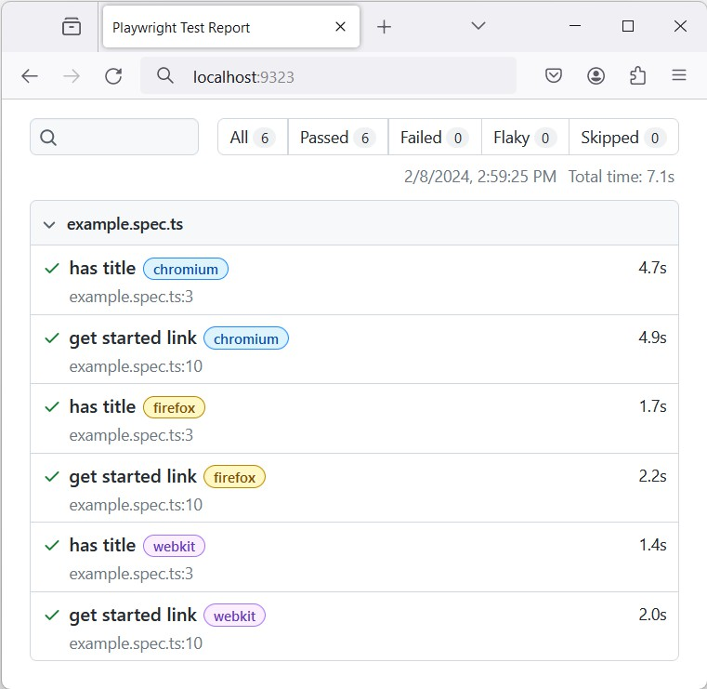
RUNNING PLAYWRIGHT TESTS
@luigi ➜ playwright-example $ npx playwright test Running 6 tests using 6 workers
6 passed (7.1s)
@luigi ➜ playwright-example $ npx playwright show-report Serving HTML report at http://localhost:9323.
By default, tests are executed on
Cchhrroommiuium
(Blink engine)
Fifrireeffooxx (Gecko engine)
ewbekbiktit (engine used by Safari and Apple devices)
Playwright can also emulate tablet and mobile browsers (Chrome and Safari)
Platforms on which tests are executed can be configured in the playwright.config.ts file

Slide 46
PLAYWRIGHT: TEST ISOLATION
Playwright achieves isolation by starting from scratch
Tests are executed in a clean environment, not influenced by earlier tests
This means that each test runs in a brand-new browser environment, with its own localStorage, sessionStorage, cookies, …
This is achieved by using a new BrowserContext for each test (you can think of a new BrowserContext as an incognito-like profile)

Slide 47
PLAYWRIGHT: ENVIRONMENT AND FIXTURES
The environment for each test is defined using Test Fixtures
Tipically, Playwright creates a new BrowserContext for each test, and provides a default Page in that context
Think of a Page as an abstraction of a tab in a brand-new browser
The {page} argument passed to the test function tells Playwright to setup the Page fixture (e.g.: create a new BrowserContext and a Page in that context)
test('has title', async ({ page }) => {
await page.goto('https://playwright.dev/');
// Expect the page has a title matching a substring.
await expect(page).toHaveTitle(/Playwright/);
});

Slide 48
WRITING E2E TESTS WITH PLAYWRIGHT
Three key parts are crucial in writing automated E2E tests
Locating elements
Performing actions
Asserting state against expectations

Slide 49
PLAYWRIGHT: LOCATING ELEMENTS
Playwright supports different ways to locate elements: docs
page.getByText(); // locate by text content.
page.getByLabel(); // locate a form control by associated label's text. page.getByPlaceholder(); // locate an input by placeholder. page.getByAltText(); // locate an element, usually image, by its text alt. page.getByTitle(); // locate an element by its title attribute. page.getByTestId(); // locate an element based on its data-testid
It is also possible to use CSS and XPATH locators
page.locator("#foo ul [data-foo]")
page.locator("//[@id='foo']//ul//*[@data-foo]")

Slide 50
PERFORMING ACTIONS
Once the intended element has been located, it is possible to programmatically interact with it
It suffices to invoke the adequate method on the located element
page.locator("#input").clear(); page.locator("#input").fill("Foo");
page.locator("#input").press("Tab"); page.locator("#checkbox").check();
page.locator("#select-course").selectOption("web technologies"); page.locator("#button").click(); page.locator("#button").dblclick();

Slide 51
ASSERTING STATE
Once the intended element has been located, it is also possible to perform test assertions on that element
To make assertions, call expect(value or locator) and then a matcher reflecting the assertion you want to make
Check out the docs for a complete reference on test assertions
expect(page.locator("#foo")).toBeDefined(); expect(page.locator("#foo")).toBeDisabled(); expect(page.locator("#foo")).toBeEmpty(); expect(page.locator("#foo")).toContainText("foo"); expect(page.locator("#foo")).toHaveClass("bar"); expect(page.locator("#foo")).toBeVisible(); expect(page.locator("#foo")).toBeInViewport();

Slide 52
CAPTURE AND REPLAY
Writing tests by hand is a time consuming task
Capture and Replay (C&R) approaches allow to automatically generate E2E test code by «recording» (capturing) user interactions
C&R allows testers to easily create re-executable E2E tests by simply interacting with the web app
Being generated automatically, C&R test code may be suboptimal
w.r.t. fragility or flakiness
We may use it as a starting point nonetheless!
Playwright supports C&R (through its Test Generator feature), so let’s
see it in action!

Slide 53
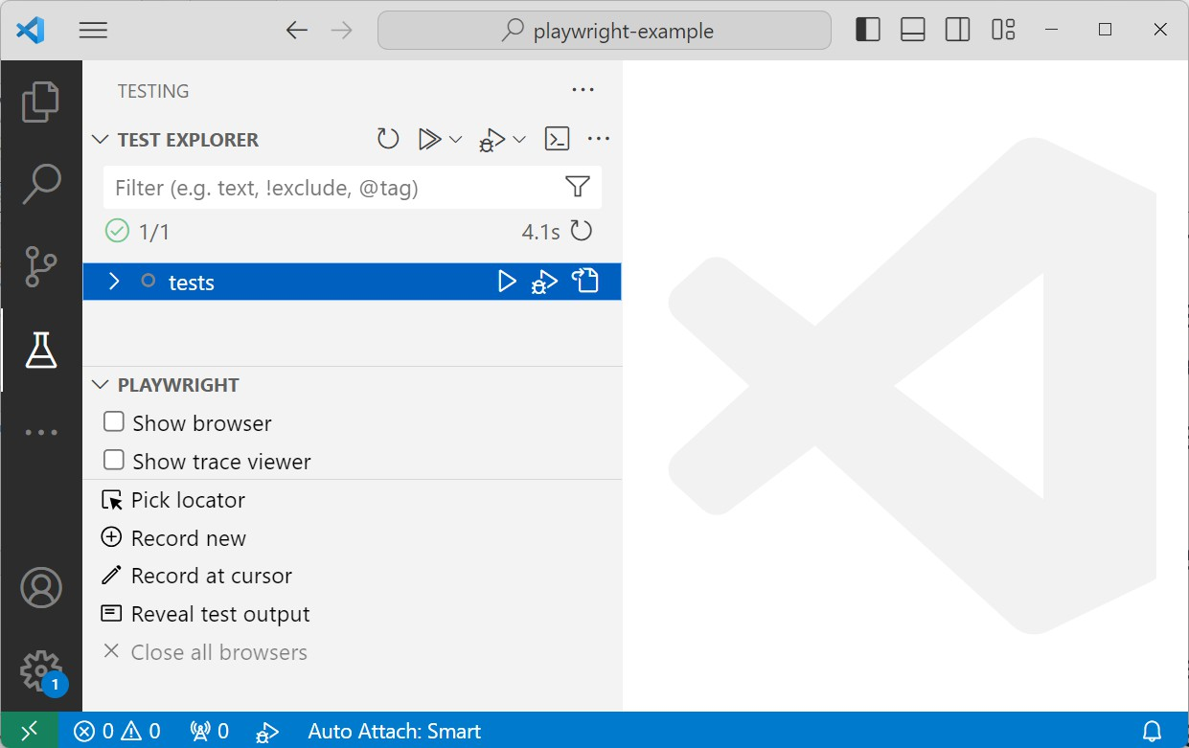

PLAYWRIGHT TEST GENERATOR
The easiest way to get started is to use the VS Code Playwright extension
In the Testing tab, under the Playwright tab, we can select
«Record new»

Slide 54
PLAYWRIGHT TEST GENERATOR
After starting the recording process, a browser window will appear
We just have to interact with the browser as an end-user
Playwright will capture all our interactions, generating the code necessary to replicate them
Built-in heuristics are used to determine the best locators
test('should login with correct credentials', async ({ page }) => { await page.goto('http://localhost:4200/home');
await page.getByRole('link', { name: 'Login' }).click(); await page.getByPlaceholder('Your username').fill('luigi'); await page.getByPlaceholder('••••••••').fill('luigi');
await page.getByRole('button', { name: 'Sign in' }).click();
await expect(page.locator('#navbar-default')).toContainText('Welcome, luigi');
});

Slide 55
REFERENCES
Angular Testing
https://angular.dev/guide/testing
Relevant parts: Overview, Basics of testing components, Component Testing Scenarios, Testing services, Code coverage
Playwright Docs
https://playwright.dev/docs/intro
Relevant parts: Getting started, Guides > Best practices

